Slide 1
Topics
String and StringBuffer
Working with Date
What is Collection?
Collections Framework
Collections Hierarchy
Collections Implementations
  Set
  List
Map

Slide 2
String
String is a immutable sequence of characters. Their value cannot be changed after they are created.
Creating String objects
String str1 = “HTC Global Services”;
String str2 = new String(”HTC”);
char data[] = {'a', 'b', 'c'};
String str = new String(data);

Slide 3
StringBuffer
A thread-safe mutable sequence of characters.
A string buffer is like a String, but can be modified.
The length and content of the sequence can be changed through certain method calls.
StringBuffer sb = new StringBuffer();
sb.append(“Buffer content”);
Initialcapacity of the buffer is 16 characters.
StringBuffer sb = new StringBuffer(int capacity);

Slide 4
Working with Date
java.util.Date class represents a specific instant in time with milliseconds precision.
    Date d = new Date();
GregorianCalendar is a concrete sub class of Calendar and provides standard calendar system.

Slide 5
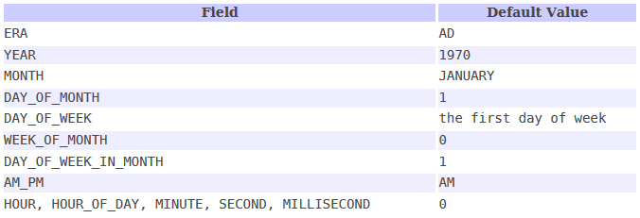
Calendar Fields

Slide 6
Formatting date
SimpleDateFormat is a concrete class for formatting and parsing dates in locale-sensitive manner.
Formatting..
SimpleDateFormat sdf = new SimpleDateFormat(String pattern);
sdf.format(new Date());
Parsing
String inputDate = “02/24/2018
Date date = sdf.parse(inputDate);

Slide 7
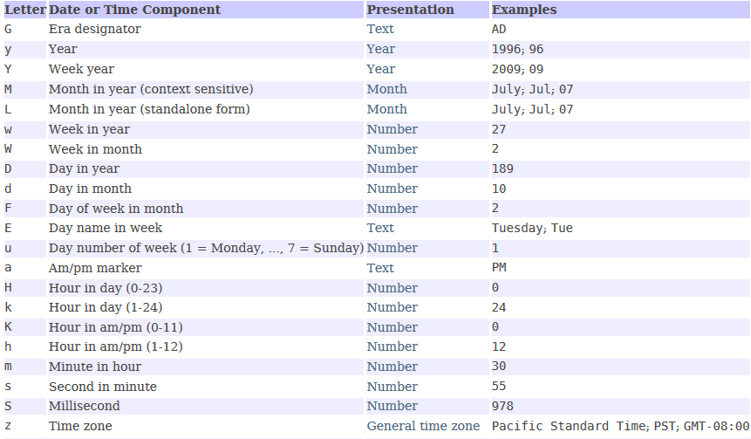
Date Patterns

Slide 8
What is a Collection
A Collection (also known as container) is an object that contains a group of objects treated as a single unit.
Any type of objects can be stored, retrieved and manipulated as elements of collections.

Slide 9
Collection Framework
Collections Framework is a unified architecture for managing collections
Main Parts of Collections Framework
  Interfaces
    Core interfaces defining common functionality exhibited by collections
  Implementations
    Concrete classes of the core interfaces providing data structures
  Operations
    Methods that perform various operations on collections

Slide 10
Collection Framework - Interfaces
Core Interface | Description
Collection | specifies contract that all collections should implement
Set | defines functionality for a set of unique elements
SortedSet | defines functionality for a set where elements are sorted
List | defines functionality for an ordered list of non- unique elements
Map | defines functionality for mapping of unique keys to values
SortedMap | defines functionality for a map where its keys are sorted

Slide 11
Collection Framework - Operations
Basic collection operations:
    Check if collection is empty
    Check if an object exists in collection.
    Retrieve an object from collection
    Add object to collection
    Remove object from collection
    Iterate collection and inspect each object
  Each operation has a corresponding method implementation for each collection type

Slide 12
Collection Characteristics
Ordered
  Elements are stored and accessed in a specific order
Sorted
  Elements are stored and accessed in a sorted order
Indexed
  Elements can be accessed using an index
Unique
  Collection does not allow duplicates

Slide 13
Iterator
An iterator is an object used to mark a position in a collection of data and to move from item to item within the collection
Syntax:
Iterator <type> = <CollectionObject>.iterator();

Slide 14
Collection class hierarchy
Collection
extends
Set
List
implements
extends
implements
HashSet
SortedSet
extends
implements
LinkedHashSet
TreeSet
LinkedList
Vector
ArrayList

Slide 15
List
value
index
“Paul”
“Mark”
“John”
“Paul”
“Luke”
0
1
2
3
4
A List cares about the index/ordering
List allows duplicate object
ArrayList
Vector
LinkedList

Slide 16
Set
“John”
“Luke”
“Paul”
“Mark”
“Fred”
“Peter”
A Set cares about uniqueness, it doesn’t allow duplicates. Ordering not guaranteed.
HashSet
LinkedHashSet
TreeSet

Slide 17
Map class hierarchy
Map
extends
implements
SortedMap
implements
Hashtable
HashMap
TreeMap
extends
LinkedHashMap

Slide 18
Map
key
value
“Pl”
“Ma”
“Jn”
“ul”
“Le”
“Paul”
“Mark”
“John”
“Paul”
“Luke”
A Map cares about unique key.
HashMap
Hashtable
LinkedHashMap
TreeMap

Slide 19
Summary
Class
Map
Set
List
Ordered
Sorted
HashMap
X
No
No
Hashtable
X
No
No
TreeMap
X
Sorted
By natural order or custom comparison rules
LinkedHashMap
X
By insertion order or last access order
No
HashSet
X
No
No
TreeSet
X
Sorted
By natural order or custom comparison rules
LinkedHashSet
X
By insertion order or last access order
No
ArrayList
X
By index
No
Vector
X
By index
No
LinkedList
X
By index
No

